Slide 1
Breakdown Voltage Modeling
Student : Ying-Lun Kao
Advisor : Dr. Hao-Hsiung Lin
Date : 107. 08. 03

Slide 2
Outline
Physics of avalanche breakdown
Abrupt/Gaussian model & simulation
Why does guard ring work?
Reference
Notes:
提出可以將 multiplication factor 近似為 parallel/cylindrical form 的理論依據、分析（講解一般形式，呈現電場分佈與近似，略提圓柱形式的推廣）
提出 APD 結構圖
提出 TCAD 模擬結果與理論數據比較圖（兩張，分別是「各種濃度的 Rd & Rj 圖」與「各種半徑的 Vb 與 Nb 圖」）
誤差分析，得出圓柱近似的可靠度
依據上述理由，提出 Guard ring 的保護理論依據與預測（double hard breakdown）
提出 GAPD 結構圖
提出 TCAD 模擬結果與理論數據比較圖（兩張，分別是）
現象一：double hard breakdown（應該可再次使用圓柱模型預測，並得出結論）
現象二：soft breakdown（拿多張同半徑但不同濃度的 I-V 圖，標記出平緩崩潰的現象，提出漏電流解釋，呈現電流強度分佈變化影片）

Slide 3
Silvaco TCAD : Net doping
Si
Si

Slide 4
Total current density @ V_{B}

Slide 5
Physics of avalanche breakdown

Slide 6
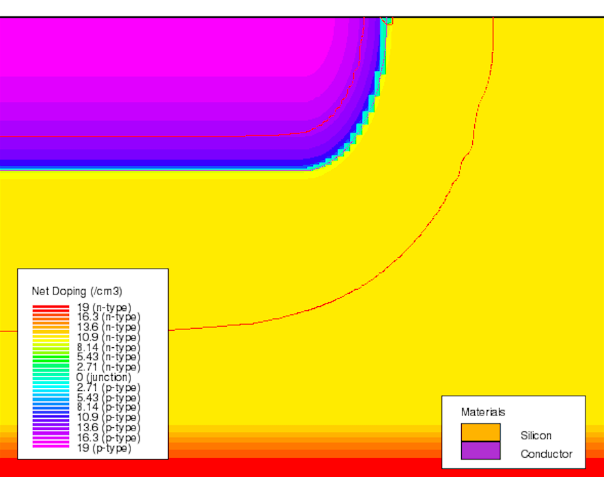
Doping profile
5 μm
1.4 μm
6 μm
10 μm

Slide 7
Doping profile
P
r_{n}
N
r_{p}
r_{j} :
2 μm
r_{p}
r_{n}
r_{lat, j}

Slide 8
Multiplication governing equation
Stillman et al., (1977), Capasso (1985)
$$\overset{⃑}{E}$$
$$J_{p}\left(0\right)$$
$$v_{p}$$
$$J_{n}\left(w\right)$$
$$J_{n}\left(0\right)$$
$$v_{n}$$
$$J_{p}\left(w\right)$$
$$x=0$$
$$x=w$$
 | $$J=J_{n}\left(x\right)+J_{p}\left(x\right)=const.$$ | $$\left(1\right)$$

Slide 9
Multiplication governing equation
Stillman et al., (1977), Capasso (1985)
 | $$\frac{d}{dx}J_{n}\left(x\right)=α\left(x\right) J_{n}\left(x\right)+β\left(x\right) J_{p}\left(x\right)+qG(x)$$ | $$\left(2\right)$$
Impact ionization rate
Generation rate
 | $$−\frac{d}{dx}J_{p}\left(x\right)=α\left(x\right) J_{n}\left(x\right)+β\left(x\right) J_{p}\left(x\right)+qG(x)$$ | $$\left(3\right)$$
$$α≈\frac{1}{\left\langle x\right\rangle } \left({cm}^{−1}\right), if \left\langle x\right\rangle ≫\frac{E_{imapct minimal energy}}{eE}$$

Slide 10
Multiplication governing equation
Stillman et al., (1977), Capasso (1985)
 | $$J=\frac{J_{p}\left(w\right)+J_{n}\left(0\right) exp\left[φ\left(w\right)\right]+q exp\left[φ\left(w\right)\right]\int_{0}^{w}{G\left(x\right) exp\left[−φ\left(x\right)\right]dx}}{1−\int_{0}^{w}{β\left(x\right) exp\left\{\int_{x}^{w}{\left[α\left(x′\right)−β\left(x′\right)\right]dx′}\right\}dx}}$$ | $$\left(4\right)$$
 | $$J=\frac{J_{p}\left(w\right) exp\left[−φ\left(w\right)\right]+J_{n}\left(0\right)+q\int_{0}^{w}{G\left(x\right) exp\left[−φ\left(x\right)\right]dx}}{1−\int_{0}^{w}{α\left(x\right) exp\left\{\int_{0}^{x}{\left[α\left(x′\right)−β\left(x′\right)\right]dx′}\right\}dx}}$$ | $$\left(5\right)$$

Slide 11
Multiplication governing equation
Stillman et al., (1977), Capasso (1985)
Assumptions:
$$\overset{⃑}{E}$$
$$J_{n}\left(w\right)$$
$$v_{n}$$
$$G\left(x\right)=0$$
$$J_{n}\left(0\right)$$
$$J_{p}\left(w\right)=0$$
$$x=0$$
$$x=w$$
 | $$M_{n}≡\frac{J_{n}\left(w\right)}{J_{n}\left(0\right)}=\frac{J}{J_{n}\left(0\right)}=\frac{1}{1−\int_{0}^{w}{α\left(x\right) exp\left\{−\int_{0}^{x}{\left[α\left(x′\right)−β\left(x′\right)\right]}dx′\right\}dx}}$$ | $$\left(6\right)$$

Slide 12
Multiplication governing equation
Stillman et al., (1977), Capasso (1985)
$$J_{p}\left(0\right)$$
Assumptions:
$$\overset{⃑}{E}$$
$$G\left(x\right)=0$$
$$v_{p}$$
$$J_{p}\left(w\right)$$
$$J_{n}\left(0\right)=0$$
$$x=0$$
$$x=w$$
 | $$M_{p}≡\frac{J_{p}\left(0\right)}{J_{p}\left(w\right)}=\frac{J}{J_{p}\left(w\right)}=\frac{1}{1−\int_{0}^{w}{β\left(x\right) exp\left\{\int_{x}^{w}{\left[α\left(x′\right)−β\left(x′\right)\right]}dx′\right\}dx}}$$ | $$\left(7\right)$$

Slide 13
APD w/o g-ring
Stillman et al., (1977), Capasso (1985)
Carrier density
p⁺ - type
n - type
-
$$\overset{⃑}{E}$$
$$p_{v}(x)$$
-
-
$$n_{c}(x)$$
r_{p}
-
+
+
+
+
+
r
$$r=0$$
$$r=r_{p}$$
$$r=r_{n}$$
$$r=∞$$
r_{n}
$$\overset{⃑}{E}$$
$$J_{p}\left(r_{p}\right)$$
$$J_{n}\left(r_{n}\right)$$
$$v_{p}$$
$$J_{n}\left(r_{p}\right)$$
$$v_{n}$$
$$J_{p}\left(r_{n}\right)$$
$$r=0$$
$$r=r_{p}$$
$$r=r_{n}$$
$$r=∞$$

Slide 14
Multiplication governing equation
Stillman et al., (1977), Capasso (1985)
 | $$1−\left(1/{M_{n}}\right)=\int_{r_{p}}^{r_{n}}{α\left(r\right)}exp\left\{−\int_{r_{p}}^{r}{\left[α\left(r′\right)−β\left(r′\right)\right]dr′}\right\}dr$$ | $$\left(8\right)$$
 | $$1−\left(1/{M_{p}}\right)=\int_{r_{p}}^{r_{n}}{β\left(r\right)}exp\left\{\int_{r}^{r_{n}}{\left[α\left(r′\right)−β\left(r′\right)\right]dr′}\right\}dr$$ | $$\left(9\right)$$
Notes:
Van Overstraeten

Slide 15
Effective ionization rate
Van Overstraeten et al., (1970), Capasso (1985)
if
$$γ≡\frac{α_{h}}{α_{e}}≈const.,$$
then
$$\int_{r_{p}}^{r_{n}}{α_{n,p}}e^{±\int{\left(⋯\right) dr′}}dr≈\int_{r_{p}}^{r_{n}}{α_{eff} dr,}$$
$$α_{eff}≡\frac{γ−1}{ln⁡\left(γ\right)}α\left(E,r\right)$$

Slide 16
Avalanche Breakdown Condition
Van Overstraeten et al., (1970), Capasso (1985)
$$∞$$
$$1$$
$$1−\left(1/M\right)≈\int_{r_{p}}^{r_{n}}{α_{eff} \left(E,r\right) dr}$$
$$\int_{r_{p}}^{r_{n}}{α_{eff} \left(E,r\right) dr→1}$$

Slide 17
Abrupt/Gaussian model & simulation

Slide 18
Abrupt model
Planar junction:
$$\frac{dE}{dr}=\frac{ρ}{ε}=\frac{eN_{a}}{ε}$$
Cylindrical junction:
$$\frac{1}{r}\frac{d}{dr}\left(rE\right)=\frac{ρ}{ε}=\frac{eN_{a}}{ε}$$

Slide 19
Abrupt model
Planar junction:
$$E\left(r\right)=\frac{eN_{d}}{ε}\left(r−r_{n}\right)$$
Cylindrical junction:
$$E\left(r\right)=\frac{eN_{d}}{2ε}\left(r−\frac{r_{n}^{2}}{r}\right)$$

Slide 20
Gaussian model
Planar junction:
$$\frac{dE}{dr}=\frac{e}{ε}\left[−N_{a,0}e^{−{\left(r/{l_{c}}\right)}^{2}}+N_{d}\right]$$
Cylindrical junction:
$$\frac{1}{r}\frac{d}{dr}\left(rE\right)=\frac{e}{ε}\left[−N_{a,0}e^{−{\left(r/{l_{c}}\right)}^{2}}+N_{d}\right]$$

Slide 21
Gaussian model
Planar junction:
$$E=\frac{e}{ε}\left[−N_{a,0}\int_{r_{n}}^{r}{e^{−{\left(\frac{r}{l_{c}}\right)}^{2}}dr+N_{d}\left(r−r_{n}\right)}\right]$$
Cylindrical junction:
$$E=\frac{eN_{a,0}l_{c}^{2}}{2εr}\left[e^{−{\left(r/l_{c}\right)}^{2}}−e^{−{\left({r_{n}}/{l_{c}}\right)}^{2}}\right]$$
$$+\frac{eN_{d}}{2εr}\left(r^{2}−r_{n}^{2}\right)$$

Slide 22
Silicon effective ionization rate
Root et al. (1960)
$$\int_{r_{p}}^{r_{n}}{α_{eff} dr→1}$$
$$α_{1}=1.953×{10}^{−24} E^{5}$$ | $$200\left({kV}/{cm}\right)≤E≤500\left({kV}/{cm}\right)$$ | ✔️
$$α_{2}=2.5×{10}^{−7} E^{2}$$ | $$500\left({kV}/{cm}\right)≤E≤750\left({kV}/{cm}\right)$$ | ❌
$$α_{3}=1.3×{10}^{5}$$ | $$750\left({kV}/{cm}\right)≤E≤1000\left({kV}/{cm}\right)$$ | ❌

Slide 23
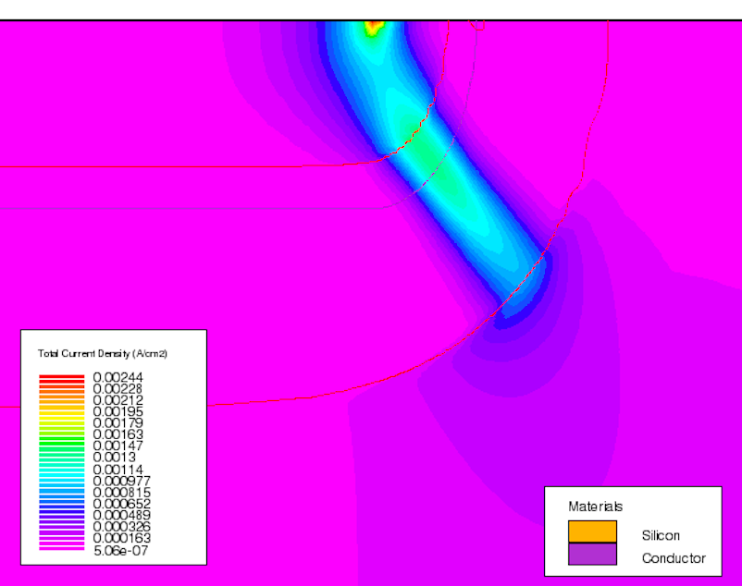
Abrupt model: V_{b} & N_{d}
r_{j}
$$N_{a}$$
$$N_{d}$$

Slide 24
Gaussian model: V_{b} & N_{d}
r_{j}
$$N_{a}$$
$$N_{d}$$

Slide 25
Abrupt model: E_{b, max} & N_{d}
r_{j}
$$N_{a}$$
$$N_{d}$$

Slide 26
Gaussian model: E_{b, max} & N_{d}
r_{j}
$$N_{a}$$
$$N_{d}$$

Slide 27
Abrupt model: r_{n} & r_{j}
r_{j}
$$N_{a}$$
$$N_{d}$$

Slide 28
Gaussian model: r_{n} & r_{j}
r_{j}
$$N_{a}$$
$$N_{d}$$

Slide 29
Why does guard ring work?

Slide 30
Why does guard ring work?

Slide 31
Why does guard ring work?
$$\int_{r_{p}}^{r_{n}}{α_{eff} dr→1}$$
$$f\left(V\right)≡\int_{r_{p}}^{r_{n}}{α_{eff} \left[E\left(V,r\right),r\right]dr →} Find f(V, path)$$

Slide 34
Thank you for listening

Slide 35
Reference
[1] C. D. Root, D. P. Lieb, and B. Jackson, “Avalanche Breakdown Voltages of Diffused Silicon and Germanium Diodes,” IRE Transactions - Electron devices, pp. 1–6, Oct. 1960.
[2] R. Van Overstraeten and H. De Man, “Measurement of the ionization rates in diffused silicon p-n junctions,” Solid State Electronics, pp. 1–26, 1970.
[3] G. E. Stillman and C. M. Wolfe, “Chapter 5 Avalanche Photodiodes,” vol. 12, Elsevier, 1977, pp. 291–393.
[4] F. Capasso, “Chapter 1 Physics of Avalanche Photodiodes,” in Lightwave Communications Technology - Photodetectors, vol. 22, Elsevier, 1985, pp. 1–172.

Slide 36
Average ionization rate
說明
遠處電場不影響
兩個公式是一樣的（？）
$$1$$

Slide 37
Average Ionization Rate
$$E\left(r\right)=−\frac{qN_{d}}{2ε}\left(r−\frac{r_{n}^{2}}{r}\right)$$
$$E\left(r\right)=−\frac{qN_{d}}{2ε}\left(r−\frac{r_{n}^{2}}{r}\right)$$

Slide 38
Gaussian junction

Slide 39
Silvaco TCAD : Electric field

Slide 40
Guard ring test
Double Hard breakdown @ 1e16
No “leakage” current

Slide 41
Guard ring test
Soft breakdown @ 3e15
Hard breakdown @ 1e16
Leakage current
Excel 紅色代表 soft breakdown 的開始

Slide 42
Simulation step
呈現回歸演算法 : y(r) 函數

Slide 43
CONCLUSIONS

